Slide 1

Data Analysis Project
Thomas Fleming
CS1030

Slide 2
Chosen Data Set
When looking for an interesting data set to analyze, the first database I choose to look at was the US Census. When I got there in the search bar it gave an example of commute in a state which got me thinking about many a conversations with friends about personal vehicles vs public transportation, so I decided to look up commute for Denver and found a data set breaking down mode of commute in Denver.

Slide 3
Chosen Data Set Cont.
Location: Denver CO.
Time Range: 2016-2020
Age Ranges: 16-19, 20-24, 25-44, 45-54, 55-59, 60+
Format Accessed: Excel

Slide 4
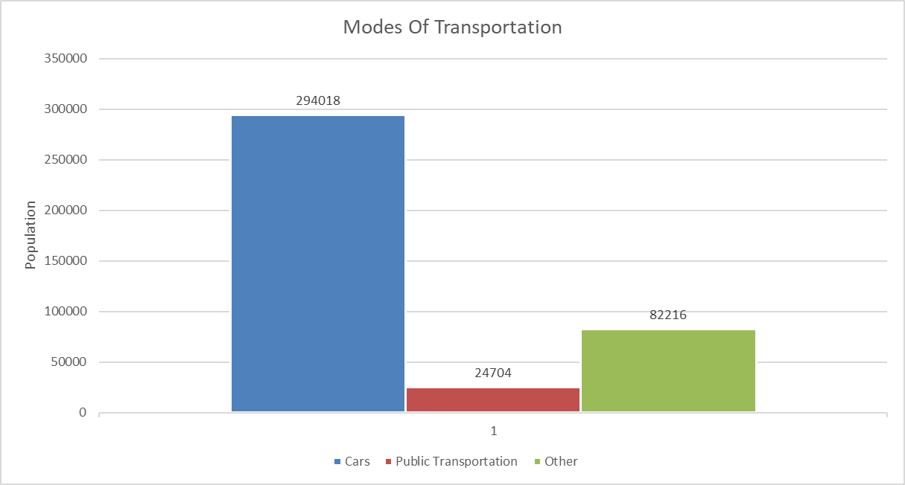
Question/Chart 1
What percentage of people commute via car vs public transportation?

Slide 5
Process 1
I combined the totals for people who rode alone and who carpooled into one data set for Cars. I then subtracted the cars data set and public transportation data set from the overall total to get my "other" data set. I then used these three data sets to create my first chart using excel.

Slide 6
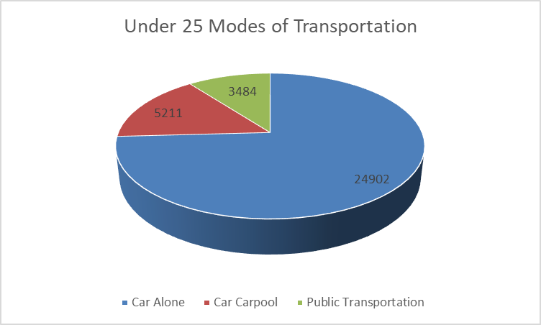
Question/Chart 2
What portion of people under 25 commute without a car?

Slide 7
Process 2
First, I took the percentages of people under 25 and added those together, then I found what percentage of the those who drove alone, carpooled, and used public transportation were under 25. Then I created the pie chart in excel.

Slide 8
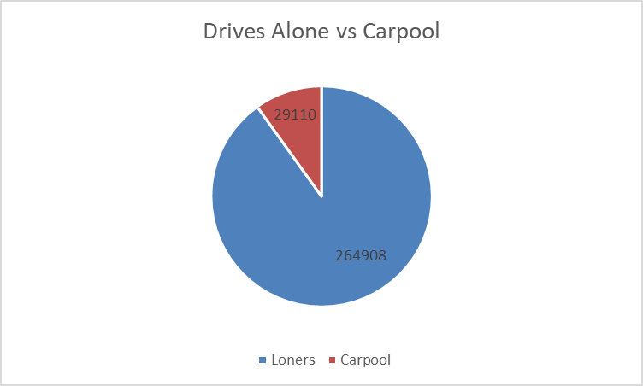
Question/Chart 3
What percentage of the population carpools vs drives alone?

Slide 9
Process 3
I took the totals for those who drove alone and those who carpooled to work and created the chart in excel.

Slide 10
Sources
Data Set: https://data.census.gov/table?q=commute+in+Denver+CCD,+Denver+County,+Colorado&tid=ACSST5Y2020.S0802
Data Analysis: Excel

